Slide 1
Data Science & Machine Learning
Ahmed Moatasem

Slide 2
WELCOME!
What do you expect from today’s session?

Slide 3
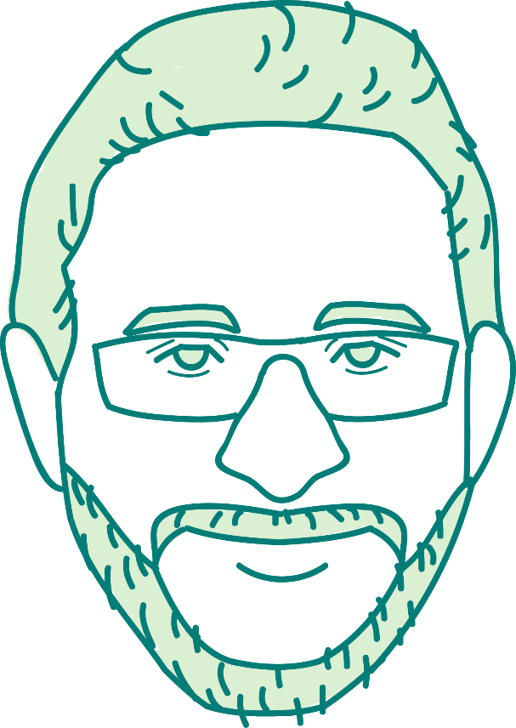




Slide 4
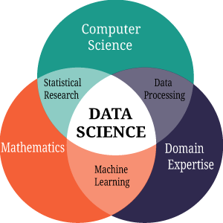
What is Data Science?

Slide 5
Data Science Landscape

Slide 6
Reading from different data sources
Structured
SQL
NoSQL
APIs
CSV
Unstructured
Web Scraping
Text Data

Slide 7


Data Processing
Cleaning
Regular Expressions
Stop Words
Reshaping Data (Feature Engineering)
Date Parsing
Categorical Variables Representation
Big Data Platforms
Map Reduce
Hadoop
Spark

Slide 8
Storytelling and Visualization
Exploratory Data Analysis
Mean
Median
Mode
Normal Distribution
Inference Statistics
Hypothesis Testing
Survival Model

Slide 9
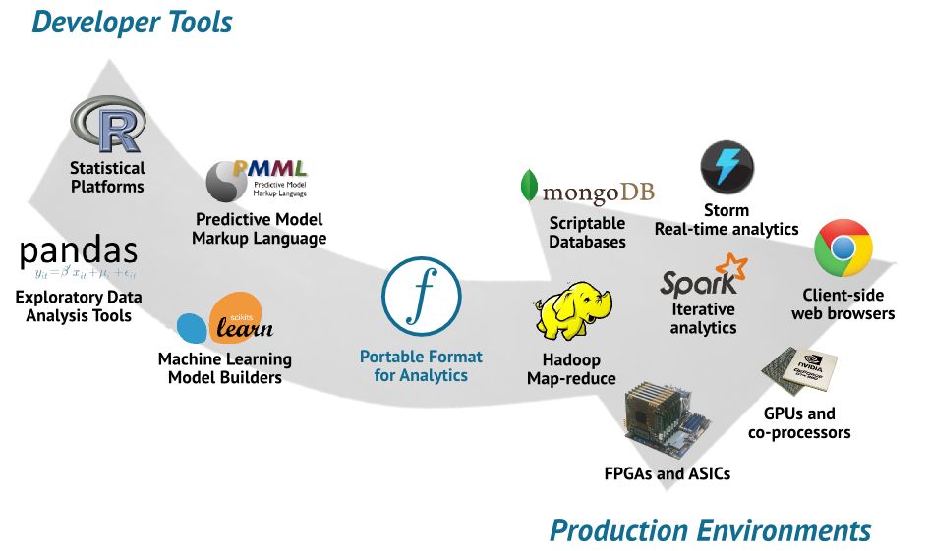

Slide 10
Before Jumping into Machine Learning

Slide 11
Machine Learning
Computer’s ability to LEARN a certain task, then perform this task to PREDICT certain outputs in order to build actions based on these predictions.

Slide 12
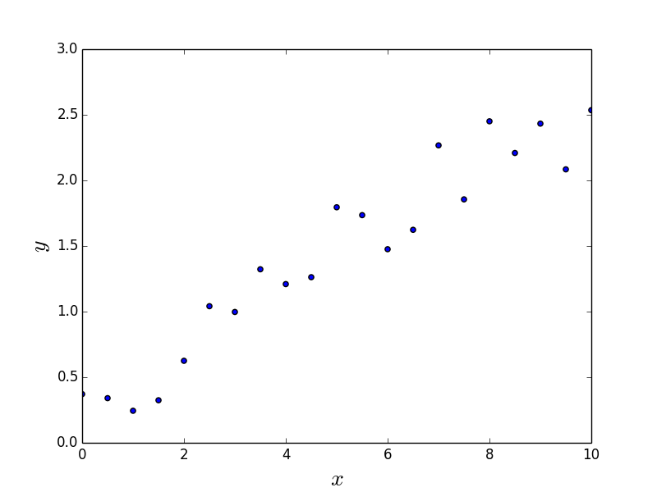
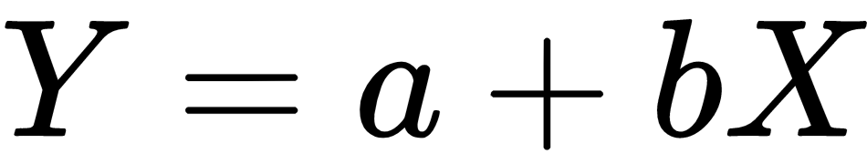
Supervised Learning - Regression
Linear Regression

Slide 13
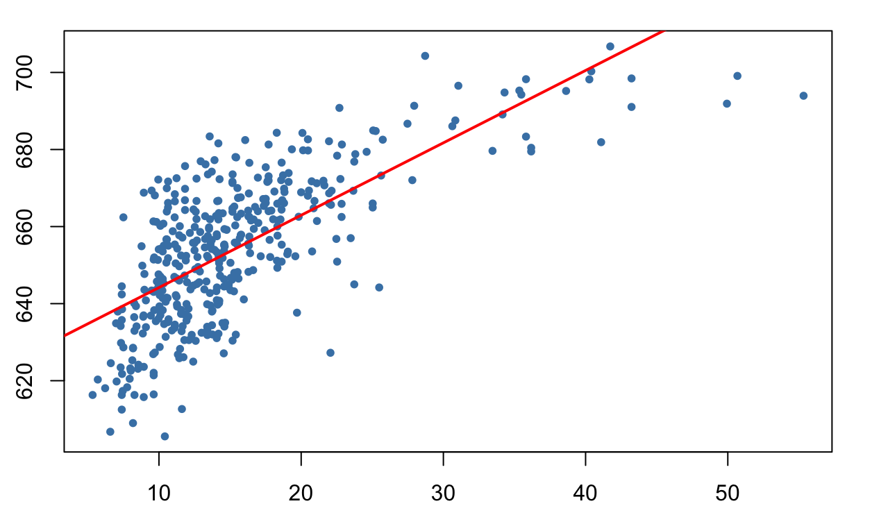
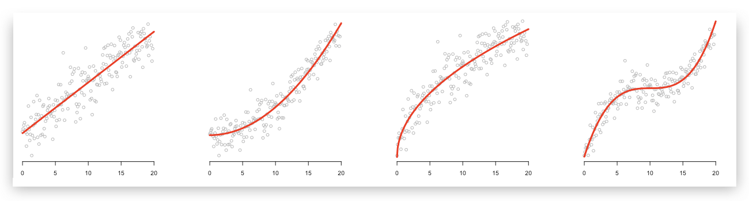
Regression

Slide 14
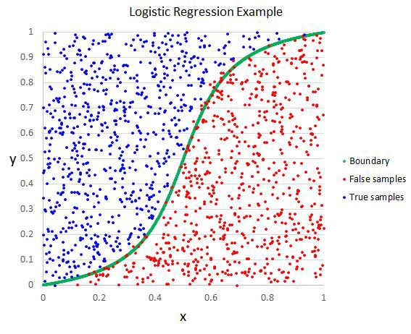
Supervised Learning - Classification
SVM

Slide 15
Unsupervised Learning - Clustering
K-Means
Centroids
Calculating Distances
Iterations

Slide 16
let's get back to some action
Feature Engineering
Filling Missing Values
Base Modeling
Model Selection
Cross Validation
Parameter Tuning

Slide 17
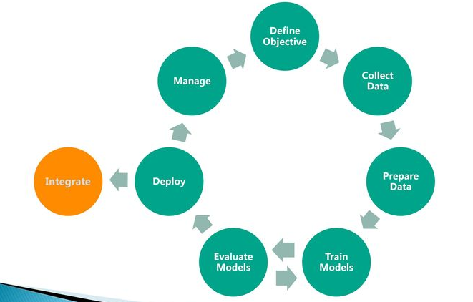
Machine Learning Cycle

Slide 18
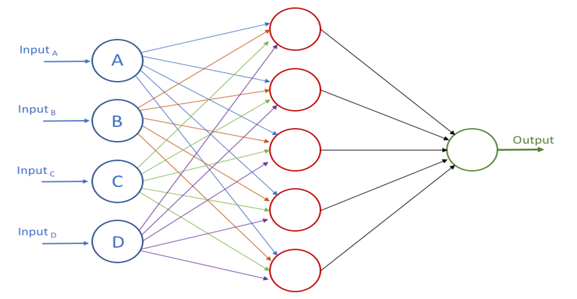
Deep Learning
Neural Networks

Slide 19
Image Recognition Convolutional Neural Networks

Slide 20
Object Character Recognition

Slide 21
Object Detection

Slide 22
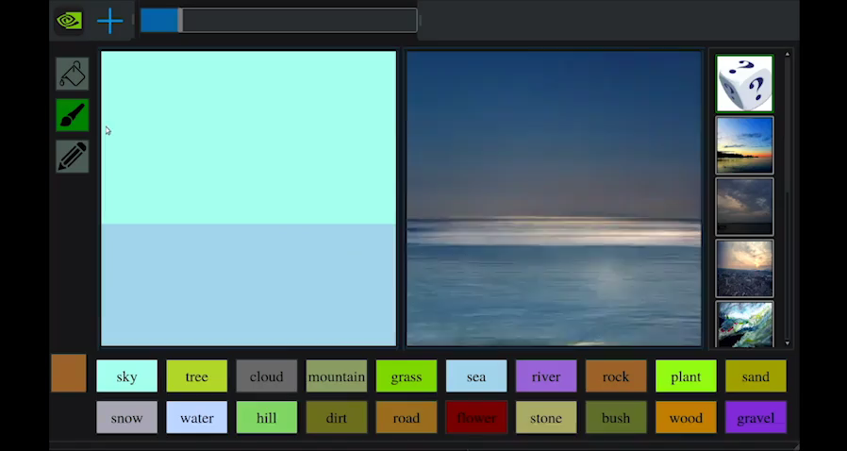
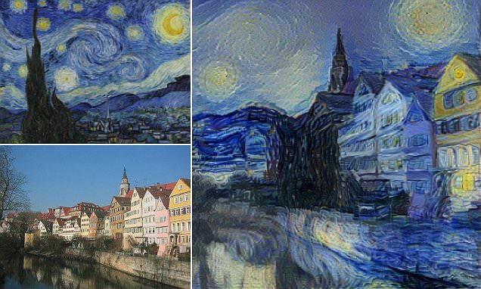
Neural Art Transfer

Slide 23
Natural Language Processing Recurrent Neural Networks

Slide 24
Applications
Sequence to Sequence Applications
Language Translation
Text Summarization
Sequence to One
Sentiment Analysis
Topic Detection

Slide 25
Roadmap!
Data Science and Machine Learning Foundation
Johns Hopkins Data Science Specialization https://www.coursera.org/specializations/jhu-data-science Stanford's Machine Learning - Andrew Ng https://www.coursera.org/learn/machine-learning Applied Data Science with Python - University of Michigan https://www.coursera.org/specializations/data-science-python Deep Learning - Andrew Ng https://www.coursera.org/specializations/deep-learning
https://github.com/ossu/data-science https://github.com/datasciencemasters/go https://github.com/airalcorn2/Michael-s-Data-Science-Curriculum

Slide 26
Thank You!

